Slide 1



AUTOMATIC STREET LIGHT CONTROLLER USING LDR & RELAY

Slide 2
A Project by : GROUP 6
RAVINDRA KASHAYAP
SAMEER ARYAN
SAURABH
SHASHI KUMAR
SWAPNIL KAMAL

Slide 3
ABSTRACT
The theme of the project is to design an automatic street light controller using a LDR and a Relay.
The street light is designed to turn ON automatically when it there is darkness and turns OFF during daytime.
The LDR is the sensor that detects the intensity of the light falling on it and accordingly the LDR-Relay controller system works.
The circuit to this system works using LDR, Transistors, Relay, Diodes, Resistors.

Slide 4
INTRODUCTION
Energy and power conservation.
Automatic street light is a simple circuitry that turns on the street lights when it is dark and remains off during daytime.
Automatic street light controller is much need device that helps conserve energy as per its working.

Slide 5
THEORY
The controller has a photoconductive device, ldr whose resistance changes proportionally to the extent of illumination.
The outside lighting condition determines the state of the street light whether to turn it on or off.
IT USES LDR, TRANSISTORS AND RELAY AS A SYSTEM TO SWITCH ON/OFF THE STREET LIGHT.

Slide 6
COMPONENTS USED
LDR (LIGHT DEPENDENT RESISTOR)
TRANSISTORS (BC547)
RESISTORS
POTENTIOMETER
SPDT RELAY
DIODE
12V BATTERY
220V LAMP

Slide 7
LDR : LDR or light dependent resistor is an electronic component that changes its resistance with the change in light intensity that falls upon it.
TRANSISTOR : A transistor is a semi-conductor device used to amplify or switch electronic signals and electrical power. BC547 used is a n-p-n bi-polar junction transistor.
RELAY : Relays are used to provide time delay functions. They are used to time the delay open and delay close of contacts. A SPDT or Single Pole Double Throw Relay is used.
RESISTOR : A resistor is an electrical component that helps control the flow of current.
POTENTIOMETER : A potentiometer is a manually adjustable variable resistor with 3 terminals.
DIODE : A diode is a semi-conductor device that acts as a one way switch for current.

Slide 8
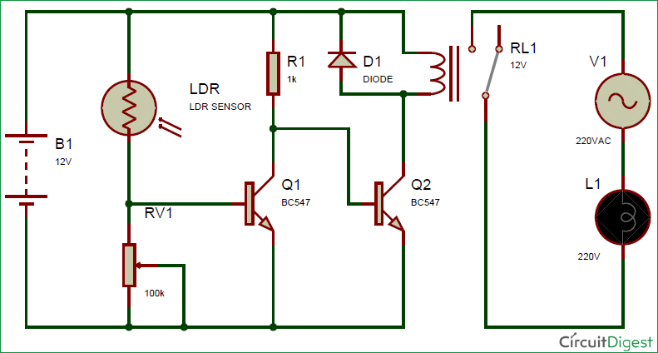
CIRCUIT DIAGRAM :

Slide 9
WORKING
WORKING OF LDR :
When sunlight falls on the LDR it becomes less resistive and allows transistor Q1 to turn ON but Q2 transistor remains turned OFF hence relay doesn’t conduct and the lights remain OFF.
When no light falls on the LDR it becomes high resistive element hence Q1 turns OFF and bias appears at Q2 and it turns ON hence Relay coil gets energized and hence the light turns ON.
The above circuit diagram states the working of the automatic controller.
WORKING OF RELAY :
When Relay is in Normally Closed Condition, the relay coil is not energised enough to conduct and hence it remains OFF.
When Relay is in Normally Open Condition, i.e., when adequate voltage is applied, the coil of the relay gets energised hence turns ON conducting the current.

Slide 10
ADVANTAGES & DISADVANTAGES
Ldr IS HIGHLY RELIABLE
LIGHT WEIGHT
AUTOMATED OPERATION
LOW POWER CONSUMPTION
FLEXIBLE AND EASY TO MANUFACTURE
IT HAS LIMITATION OF POWER
LIGHT TURNS ON WHEN SHADOW FALLS ON THE LDR
THE LDR SHOULD BE ADEQUATELY SENSITIVE

Slide 11
CONCLUSION
MORE EFFECTIVE IN CASE OF COST, MANPOWER AND SECURITY
THE CIRCUIT WAS SIMULATED PROPERLY USING PROTEUS 8 SOFTWARE
THIS AUTOMATIC STREET LIGHT CONTROLLER IS VERY EFFICIENT AND HELPS IN ENERGY CONSERVATION and reduces human effort.
Such more automated devices with these benefits are needed that can reduce pollution and conserve energy.

Slide 12
Future scope
We can save the energy for the future use and we can control the losses of the power. We can implement this project for the home lamp or night lamp of the room. Automatic Control Systems like these can also be designed using Arduino or microcontrollers.

